Slide 1


1095-B Updates
6/14/2022

Slide 2
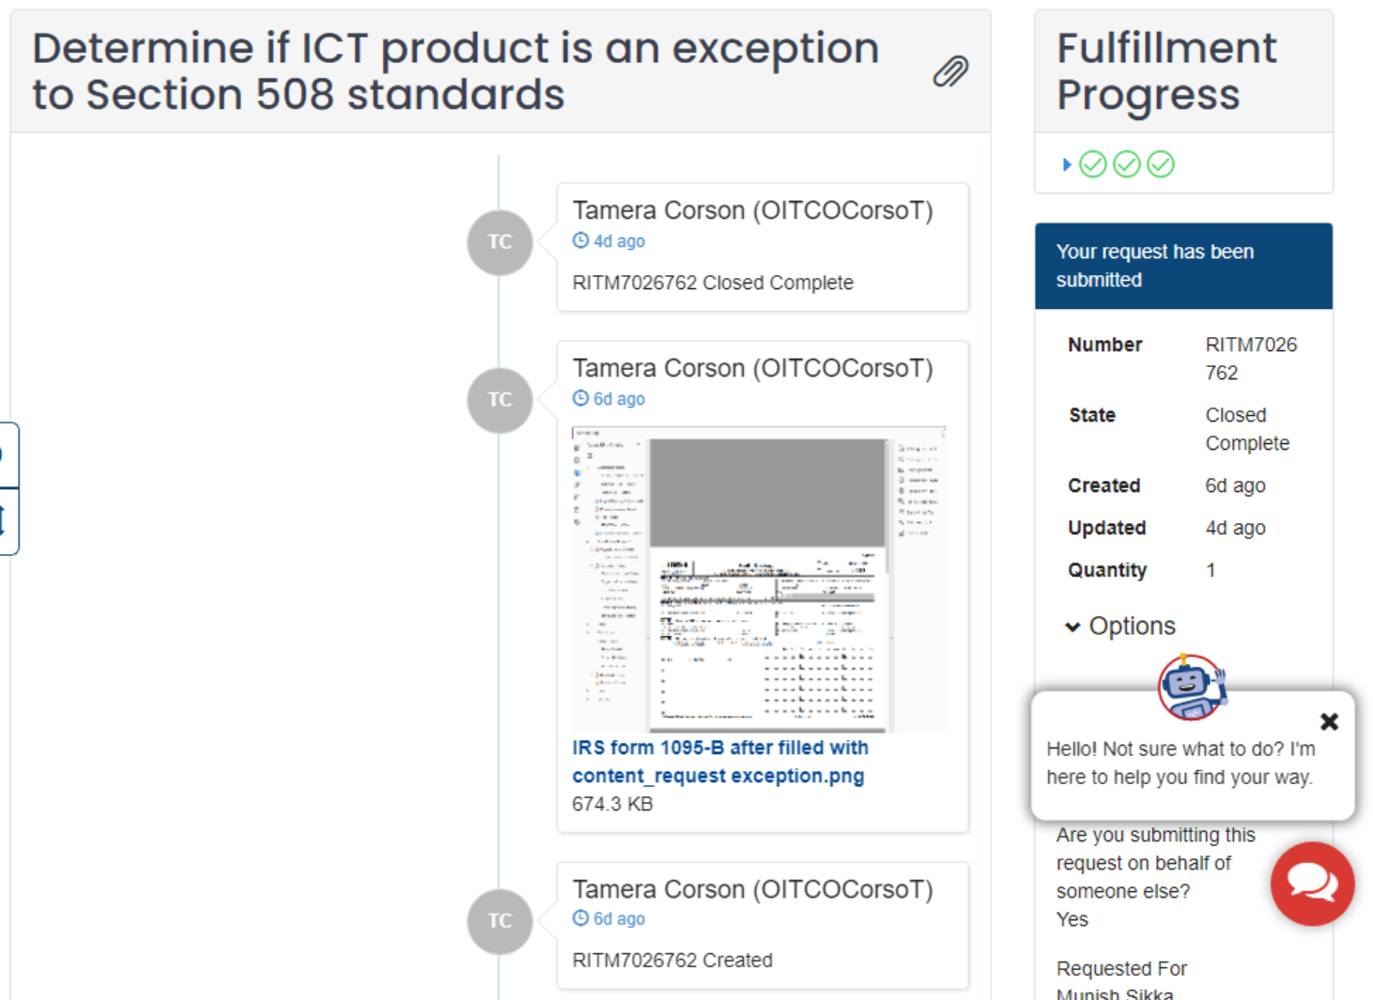
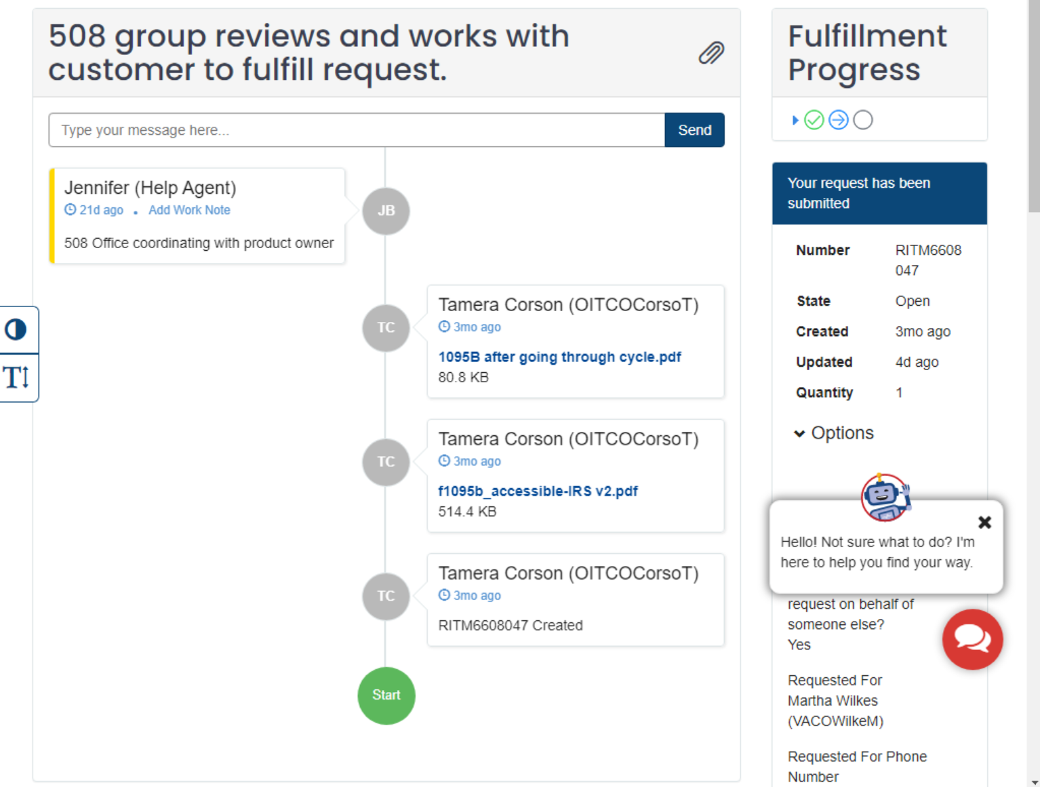
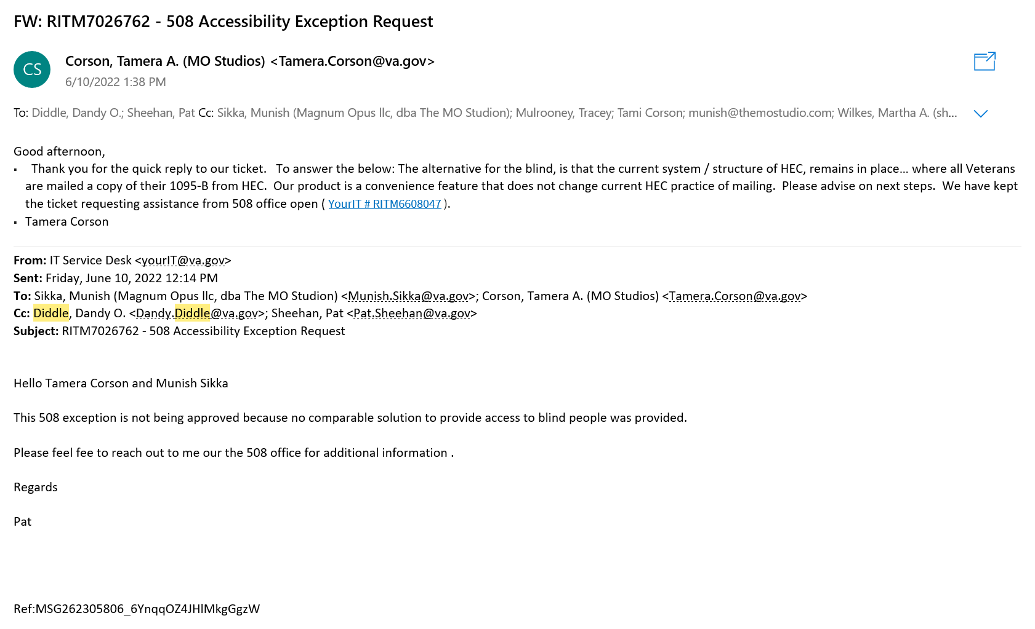
VA 508 Office
6/14/2022
Z#39722 RITM6608047
Z#42660 RITM7026762

Slide 3
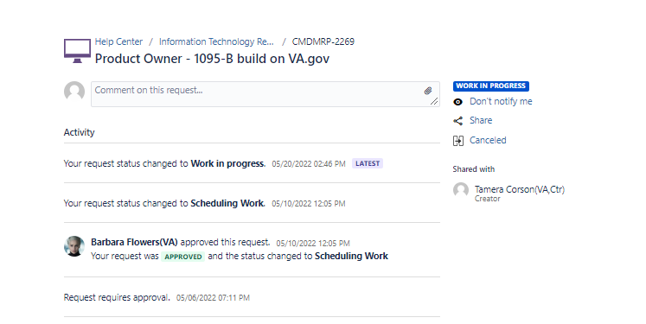
VA Profile (opt-in)
6/14/2022
Z#39723 CMDMRP-2269

Slide 4
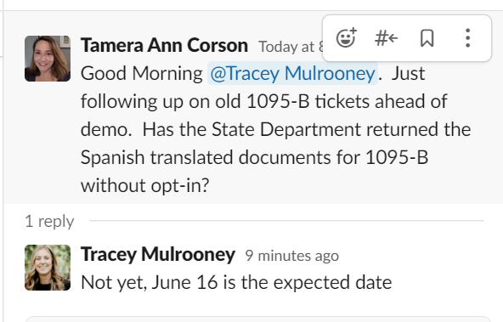
Spanish Translation for HEC
6/14/2022
Z# 40454

